Slide 1
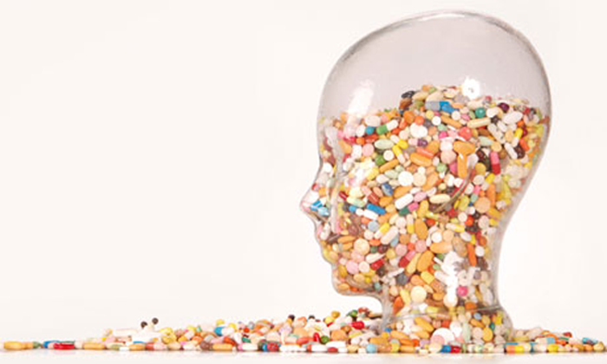
Project report
Top 200 Drugs
Reviews and Ratings
Presented by
Jatin Patel
Nimisha Patel
Prakriti Rana

Slide 2
Introduction :
Top 200 drugs reviews provided by the ClinCalc DrugStats Database.
Brand name and Generic name different drugs.

Slide 3
Data Sources :
https://clincalc.com/DrugStats/Top200Drugs.aspx
https://www.rxassist.org/pap-info/generic-drug-list-print
https://www.kaggle.com/shiffy46/drug-reviews/data

Slide 4
Data Gathering :
We referred stats.com to extract data of the top 200 Drugs which summarized total prescribed prescription and changes on the prescriptions drugs.
rxassist.org gives the details of the listed drugs Generic name and brand name of 200 listed drugs which is extracted from the stats.com.
kaggle.com gives the details of the data (i.e. Drugs, conditions, reviews and rating ) which convert data into data frame.
Finally, merge the data and give the final dataframe to get the combine result of extracted data.

Slide 5
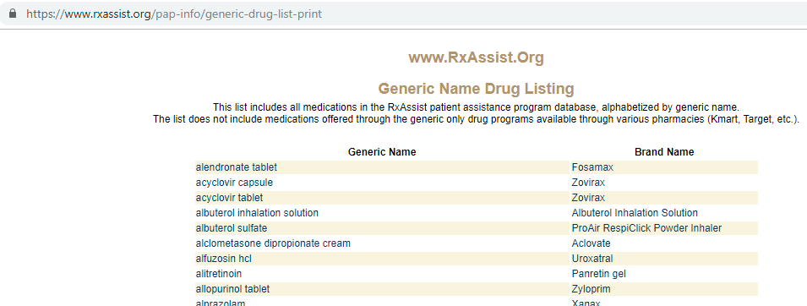
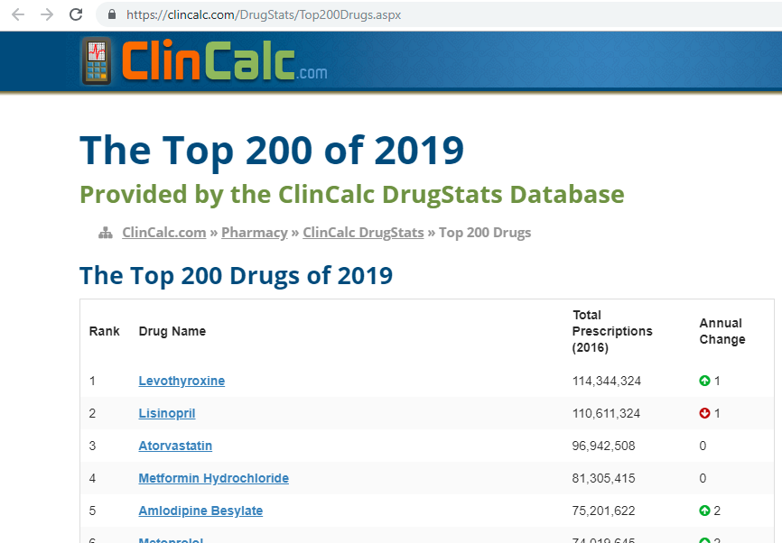
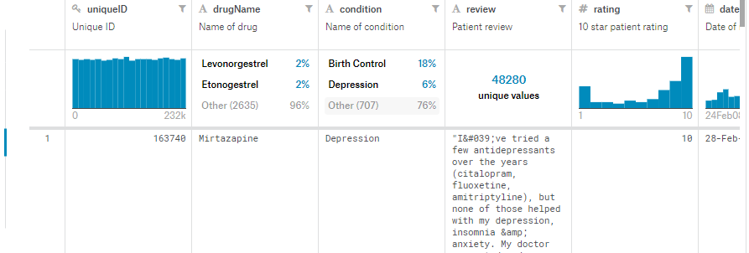
Data Extraction:
Data source 1: Data was extracted from Rxassist.com website in an HTML format.
Data source 2: This data was collected from Kaggle.com in a CSV format.
Data source 3: The data was extracted from clini-calc.com website in an HTML format.

Slide 6
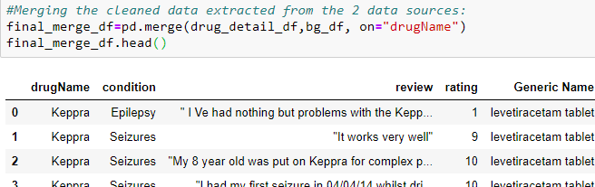
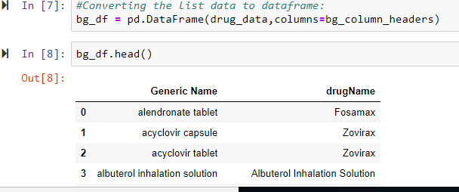
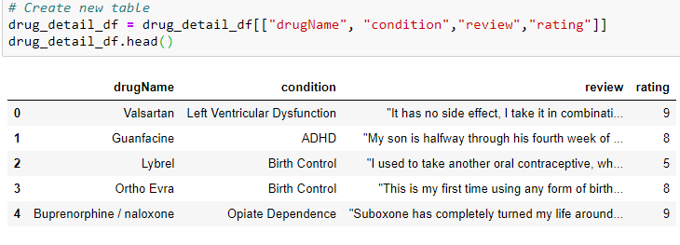
Data transformation
Removed unnecessary columns from data sets
Converted the Raw (html, csv) data into Pandas data frames
Merged the collected data of pertaining information into a single data frame.

Slide 7
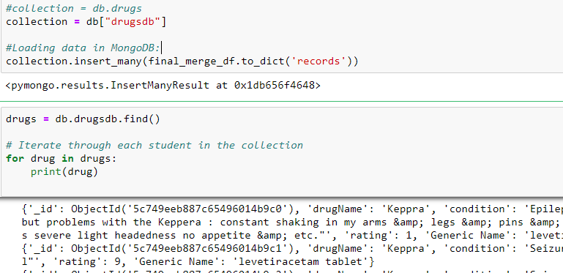
Data loading
MongoDB was selected as the preferred database to load the extracted data
The ease of use and portability was the deciding factor in choosing the database

